Slide 1
Radiology & Cardiology Management
Provider Orientation Session for Summit Health
Effective January 1, 2021
Notes:
Thank you for joining, my name is ______ , I am a Regional Provider Engagement Manager with eviCore healthcare and will be your presenter today. I have all attendees muted at this time to avoid background noise. Feel free to use the chat feature for any questions you may have throughout the presentation. All registrants will receive an email once we have concluded our session that includes a link to the provider resource site where you can find a copy of this presentation.
Throughout the presentation, we will be asking you questions from time to time to ensure you are gaining what you need from this session. Speaking of that—let’s start with some audience participation. Who would like to share what you hope to gain from attending this session?
(Keep asking until at least 1 or 2 attendees respond. Anticipate responses such as understanding the process, using the portal, avoiding P2Ps, etc., then mention that these items will be covered during the presentation.)

Slide 2
Agenda
Company Overview
Clinical Approach
Program Overview
Submitting Requests
Prior Authorization Outcomes & Special Considerations
Reconsideration Options
Provider Portal Overview
Additional Provider Portal Features
Provider Resources
Q & A

Slide 3
Company Overview

Slide 4

Medical Benefits Management (MBM)
Addressing the complexity of the healthcare system
10 Comprehensive
solutions
Evidence-based
clinical guidelines
5k⁺ employees,
including
1k+ clinicians
Advanced, innovative,
and intelligent
technology

Slide 5
Clinical Approach

Slide 6

Evidence-Based Guidelines
The foundation of our solutions
Dedicated
pediatric
guidelines
Contributions from a panel of community physicians
Experts
associated
with academic institutions
Current
clinical
literature
Aligned with National Societies:
American College of Cardiology
American Heart Association
American Society of Nuclear Cardiology
Heart Rhythm Society
American College of Radiology
American Academy of Neurology
American College of Chest Physicians
American College of Rheumatology
American Academy of Sleep Medicine
American Urological Association
National Comprehensive Cancer Network
American Society for Radiation Oncology
American Society of Clinical Oncology
American Academy of Pediatrics
American Society of Colon and Rectal Surgeons
American Academy of Orthopedic Surgeons
North American Spine Society
American Association of Neurological Surgeons
American College of Obstetricians and Gynecologists
The Society of Maternal-Fetal Medicine
Notes:
Let’s try more audience participation. Who can tell me what the “evi” part of eviCore stands for? Hint: The answer is on the screen.
(Then explain how it stands for our evidence-based guidelines.)
Our clinical guidelines are some of the most comprehensive in the industry.
Multiple sources of input including feedback from health plan partners
Based on Clinical Presentation
Compliant with Medicare NCDs/LCDs

Slide 7

Clinical Staffing – Multispecialty Expertise
Dedicated nursing and physician specialty teams for a wide range of solutions
Anesthesiology
Cardiology
Chiropractic
Emergency Medicine
Family Medicine
Family Medicine / OMT
Public Health & General
Preventative Medicine
Gastroenterology
Internal Medicine
Cardiovascular Disease
Critical Care Medicine
Endocrinology, Diabetes
& Metabolism
Geriatric Medicine
Hematology
Hospice & Palliative Medicine
Medical Oncology
Pulmonary Disease
Rheumatology
Sleep Medicine
Sports Medicine
Medical Genetics
Nuclear Medicine
OB / GYN
Maternal-Fetal Medicine
Oncology / Hematology
Orthopedic Surgery
Otolaryngology
Pain Mgmt. / Interventional Pain
Pathology
Clinical Pathology
Pediatric
Pediatric Cardiology
Pediatric Hematology-Oncology
Physical Medicine & Rehabilitation
Pain Medicine
Physical Therapy
Radiation Oncology
Radiology
Diagnostic Radiology
Neuroradiology
Radiation Oncology
Vascular & Interventional Radiology
Sleep Medicine
Sports Medicine
Surgery
Cardiac
General
Neurological
Spine
Thoracic
Vascular
Urology
400⁺
medical directors
1k⁺
nurses
Covering 51
specialties
Notes:
We have Board Certified Medical Directors and dedicated nursing teams for each of our solutions. In the instance a physician needs to conduct a clinical consultation with an eviCore Medical Director, we have physicians available in the same specialty and/or area of expertise.

Slide 8
Utilization Management – the Prior Authorization Process
Based on evidence-based guidelines, request is Approved.
Based on evidence-based guidelines, request is Denied.
Visit to provider
Provider requests prior authorization
An Approval Letter will be issued with authorization information to both the provider (facsimile) and member (mailed).
Appropriate Decision
A denial letter with clinical rational for the decision and appeal rights will be issued to both the provider and member.
Easy for
Providers
and staff
Clinical decision support
Nurse
review
MD
review
Appropriate decision
Peer-to-peer
Notes:
Now that we have went over the what services and members require prior authorization, it’s time to discuss the methods of requesting authorization through eviCore and how our clinical processing is designed.
Essentially, The patient will visit the provider and will provide their demographic information (Member Id, DOB, First and Last Name, Address, Phone, etc.). Based on the physician’s findings, the provider will be able to indicate a diagnosis and the requested study.(CPT Code and ICD10 code). From here the provider will request prior authorization for a study either by phone, fax or web. Once the case has been started providers will need to provide the most accurate clinical information related to the patient’s diagnosis (during the clinical collection pathways) to ensure the request meets medical necessity.
If the request meets medical necessity based on the clinical information provided, providers could have the potential to receive real-time approval. If additional clinical information is required to prove medical necessity the request will be set to pending and assigned to a clinical reviewer for further processing.

Slide 9
Program Overview
Notes:
Now we will discuss the prior authorization process specific to [Client Name].

Slide 10
Summit Health Prior Authorization Services
eviCore healthcare (eviCore) will begin accepting prior authorization requests for radiology & cardiology services on December 14, 2020 for dates of service January 1, 2021 and after for Medicare Advantage members.
Prior authorization applies to the following services:
Outpatient Diagnostic Elective / Non-emergent
Prior authorization does NOT apply to services performed in:
Emergency Rooms Observation Services Inpatient Stays
Providers should verify member eligibility and benefits on the secured provider log-in section at: https://www.yoursummithealth.com
Notes:
You can begin submitting your prior authorization requests on [phone live] for dates of service [program live] and after. Prior authorization is required for outpatient, diagnostic and elective services. Any services that are performed in the emergency room, as an observation or inpatient stay do NOT require prior authorization thru eviCore.
The members eligibility can be verified by going to the health plans website listed at the bottom.

Slide 11

Radiology Solution
Covered Services:
Advanced imaging services
CT, CTA
MRI, MRA
PET, PET/CT
Nuclear Medicine
To find a complete list of radiology Current Procedural Terminology (CPT) codes that require prior authorization through eviCore, please visit:
https://www.evicore.com/resources/healthplan/SummitHealth
Notes:
eviCore’s radiology solution includes advanced imaging services and primary imaging services. You can find a full list of CPT codes that require prior authorization through eviCore by viewing the provider resource site at the link below. I will be sending this link to you once our session today has ended for you to reference all the training materials available.

Slide 12

Cardiology Solution
Covered Services:
Advanced imaging and diagnostic services
Stress Testing
  Myocardial Perfusion Imaging (SPECT & PET)
  Stress Echocardiography
Cardiac CT & MRI
Echocardiography; Transthoracic, Transesophageal
Diagnostic Heart Catheterization
Implantable device services
Pacemakers
Implantable Cardioverter Defibrillator (ICD)
To find a complete list of radiology Current Procedural Terminology (CPT) codes that require prior authorization through eviCore, please visit:
https://www.evicore.com/resources/healthplan/SummitHealth
Notes:
For the Cardiology program, eviCore manages both Primary and Advanced Imaging and Implantable Device Services.

Slide 13
Submitting Requests

Slide 14

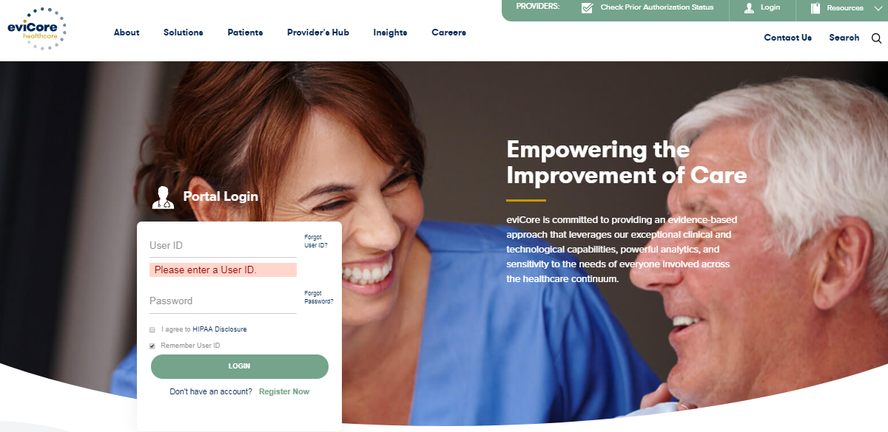
Methods to Submit Prior Authorization Requests
eviCore Provider Portal (preferred)
The eviCore online portal www.eviCore.com is the quickest, most efficient way to request prior authorization and check authorization status, and it’s available 24/7
Phone Number:
844-303-8451
Monday through Friday:
7 am – 7 pm local time
Fax Number:
800-540-2406
PA requests are accepted via fax and can be used to submit additional clinical information, portal preferred
WEB

Slide 15
Benefits of Provider Portal
Did you know that most providers are already saving time submitting prior authorization requests online? The provider portal allows you to go from request to approval faster. Following are some benefits & features:
Saves time: Quicker process than phone authorization requests
Available 24/7: You can access the portal any time and any day
Save your progress: If you need to step away, you can save your progress and resume later
Upload additional clinical information: No need to fax in supporting clinical documentation, it can be uploaded on the portal to support a new request or when additional information is requested
View and print determination information: Check case status in real-time
Dashboard: View all recently submitted cases
Duplication feature: If you are submitting more than one prior authorization request, you can duplicate information to expedite submittals

Slide 16

Keys to Successful Prior Authorizations
To obtain prior authorization on the very first submission, the provider submitting the request will need to gather four categories of information:
Member
ID
Member name
Date of birth (DOB)
2. Referring (Ordering) Physician
Physician name
National provider identifier (NPI)
Phone & fax number
3. Rendering Facility
Facility name
Address
National provider identifier (NPI)
Tax identification number (TIN)
Phone & fax number
4. Supporting Clinical
Pertinent clinical information to substantiate medical necessity for the requested service
CPT/HCPCS Code(s)
Diagnosis Code(s)
Previous test results
Notes:
To avoid any delays with obtaining your authorization on your first submission, the following information should be submitted:
Member name, ID and date of birth.
The referring/ordering physicians name, NPI and contact information.
The rendering facility name, NPI, TIN and contact information.
And supporting clinical information that can include a relevant history and physical examination, summary of the patient’s condition, imaging, pathology, laboratory reports, indication for the requested service and prior treatment such as conservative care.
eviCore has clinical worksheets available on our website at www.eviCore.com to assist with the clinical questions that are asked when submitting a request. I will review where to find this information shortly.

Slide 17
Insufficient Clinical – Additional Documentation Needed
Additional Documentation to Support Medical Necessity
If all required pieces of documentation are not received, or are insufficient for eviCore to reach a determination, the following will occur:
A Hold Letter will be faxed to the Requesting Provider requesting additional documentation
The Provider must submit the additional information to eviCore
eviCore will review the additional documentation and reach a determination
To ensure that a determination is completed within the designated timeframe, the case will remain on hold until the requested information is received.
Requested information must be received within the timeframe as specified in the Hold Letter.
  Determination will be completed within 2 business days
Appropriate Decision
Notes:
It’s important to include complete clinical information to avoid any delays with obtaining authorization. If additional clinical documentation is needed, eviCore will fax a hold letter requesting specific information. The letter will include a timeframe of when the information must be received prior to making a determination. eviCore will review the additional documentation and make a medical necessity determination within 2 calendar days.
3 faxes & 3 calls

Slide 18
Prior Authorization Outcomes &
Special Considerations

Slide 19
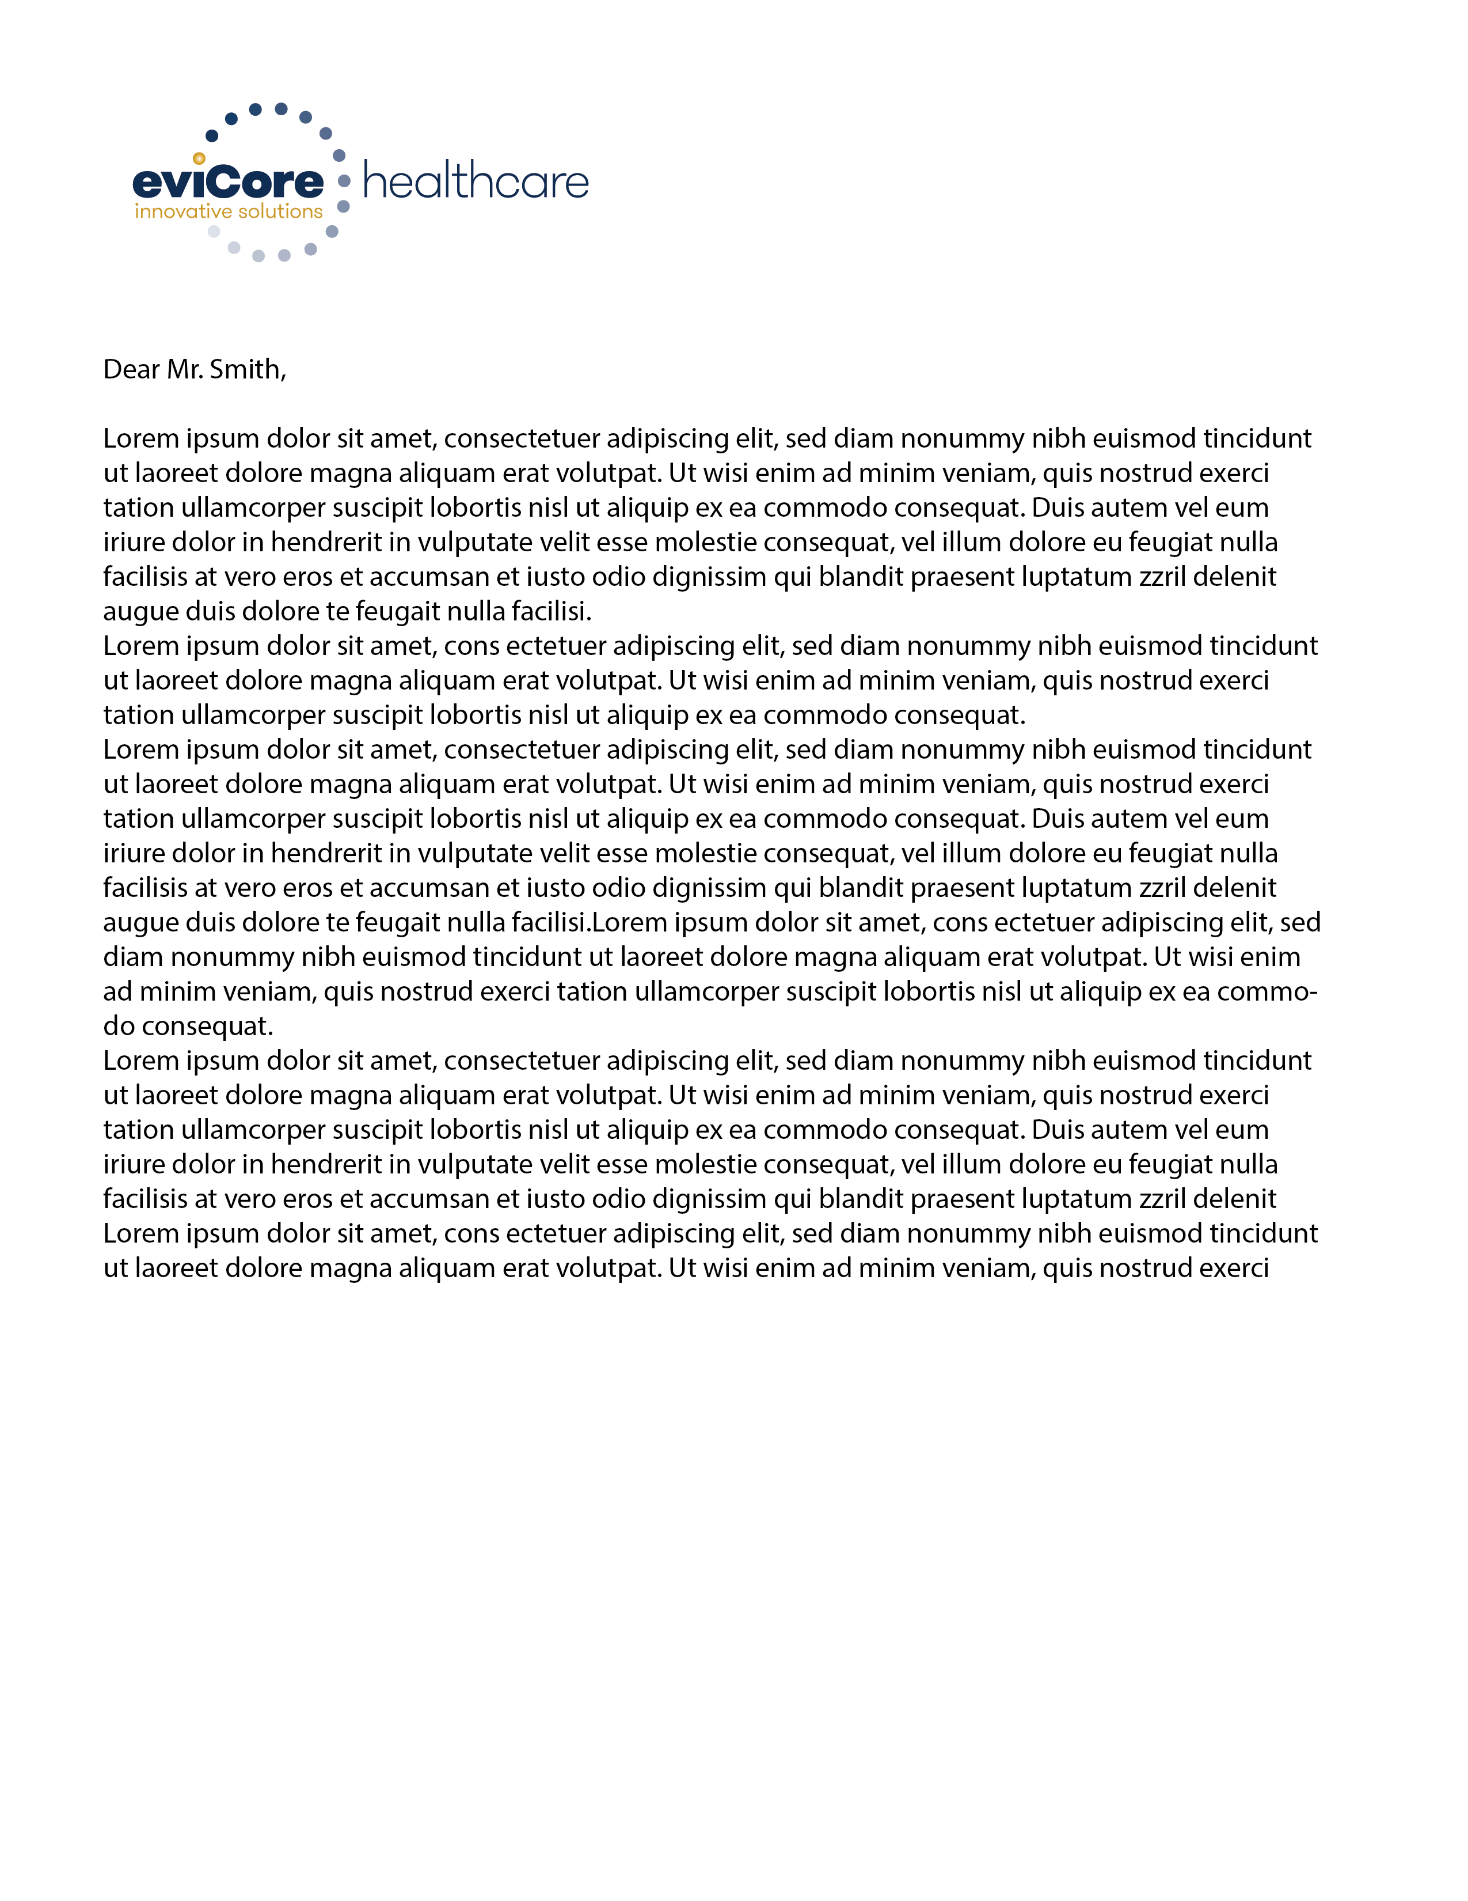
Prior Authorization Approval
Approved Requests
Standard requests are processed within 2 business days after receipt of all necessary clinical information
Urgent requests are processed within 24 hours after receipt of complete clinical information
Authorizations are valid for 90 days from the date of the determination
Authorization letters will be faxed to the ordering physician & rendering facility
When initiating a case on the web you can receive e-notifications when a determination is made Members will receive a letter by mail
Approval information can be printed on demand from the eviCore portal: www.eviCore.com
Notes:
Based on the information provided during the case submission process, eviCore will render a decision on whether the requested services do and/or do not meet medical necessity.
Once the request has been approved, eviCore will fax the approval letter to the ordering and rendering provider and mail the letter to the member. Providers and/or staff can also receive and print approval information on our online portal (www.evicore.com). Authorizations will be are valid for ____ days from the date eviCore approved the services. If the services are not rendered within the authorization dates provided, please contact eviCore directly to see if an extension is available.
In the instance that eviCore denies the services based on the clinical information provided, a denial letter containing the reason (rationale) and reconsideration options will be faxed to the ordering physician and mailed to the member. We do not provide the denial letter or information of the denial to the facility and recommend authorization be obtained prior to scheduling and/or rendering services to the member. Failure to obtain authorization from eviCore can result in non-payment and denial of claims.

Slide 20


When a Request is Determined as Inappropriate
Based on evidence-based guidelines, request is determined as inappropriate.
Appropriate Decision
A denial letter with the rationale for the decision and the appeal rights will be issued to both the provider and member.
Notes:
eviCore uses evidence-based clinical criteria when reviewing all prior authorization requests. If the request is determined as inappropriate an adverse determination letter will be sent to the provider and the patient with clinical rationale and reconsideration options. I will review the reconsideration options shortly.

Slide 21

Special Circumstances
Retrospective (Retro) Authorization Requests
Requests are not allowed after the service was performed
Urgent Prior Authorization Requests
eviCore uses the NCQA/URAC definition of urgent: when a delay in decision-making may seriously jeopardize the life or health of the member
Can be initiated on provider portal or by phone
Urgent request will be reviewed within 24 hours after receiving complete clinical information
Notes:
Here are some special circumstances that we felt you may need/want to know depending on your familiarity with eviCore and the prior authorization process.
Retrospective Authorization Requests:
In order to receive authorization for services that have already been rendered, providers are required to provide all clinical information to prove the request was medically necessary at the time of service.
Urgent Prior Authorization Requests:
Urgent requests must be medically necessary and urgent as stated by NCQA. Urgent requests can be started online at evicore.com or telephonically by calling XXX-XXX-XXXX and advising the intake representative the request is Urgent. In most instances an approval will be given during the initiation process, but if further review

Slide 22
Special Circumstances cont.
Alternative Recommendation
An alternative recommendation may be offered, based on eviCore’s evidence-based clinical guidelines
The ordering provider can either accept the alternative recommendation or request a reconsideration for the original request
Providers have up to 60 business days to contact eviCore to accept the alternative recommendation
Authorization Update
If updates are needed on an existing authorization, you can contact eviCore by phone
  Medical necessity review is needed for upcode contrast of an approved request & if changing the modality
If the authorization is not updated and a different facility location or CPT code is submitted on the claim, it may result in a claim denial
Notes:
Alternative recommendation may be offered via phone and fax based on eviCore’s evidence-based clinical guidelines.

Slide 23
Reconsideration Options

Slide 24

Post-Decision Options
My case has been denied. What’s next?
Providers are often able to utilize post-decision activity to secure case review for overturn consideration
Your determination letter is the best immediate source of information to assess what options exist on a case that has been denied
Notes:
Once a request has been reviewed and denied (Not Medically Necessary), it is important to know what reconsideration options are available. Post-Decision options can very depending on the members line of business and rules set forth by the health plan.
Here we have outlined what reconsideration options apply to the commercial memberships we will be handling.

Slide 25
Pre-Decision Options: Medicare Members
I’ve received a request for additional clinical information. What’s next?
Submission of Additional Clinical Information
eviCore will notify providers telephonically and in writing before a denial decision is issued on Medicare cases
You can submit additional clinical information to eviCore for consideration per the instructions received
Additional clinical information must be submitted to eviCore in advance of the due date referenced
Pre-Decision Clinical Consultation
Providers can choose to request a Pre-Decision Clinical Consultation instead of submitting additional clinical information
The Pre-Decision Clinical Consultation must occur prior to the due date referenced
If additional information was submitted, we proceed with our determination and are not obligated to hold the case for a Pre-Decision Clinical Consultation, even if the due date has not yet lapsed
Note: Providers can request a Clinical Consultation with an eviCore physician to better understand the reason for denial however, once a denial decision has been made, the decision cannot be overturned via Clinical Consultation
Notes:
Once a request has been reviewed and denied (Not Medically Necessary), it is important to know what reconsideration options are available. Post-Decision options can very depending on the members line of business and rules set forth by the health plan.
Here we have outlined what reconsideration options apply to the commercial memberships we will be handling.

Slide 26
Provider Portal Overview

Slide 27
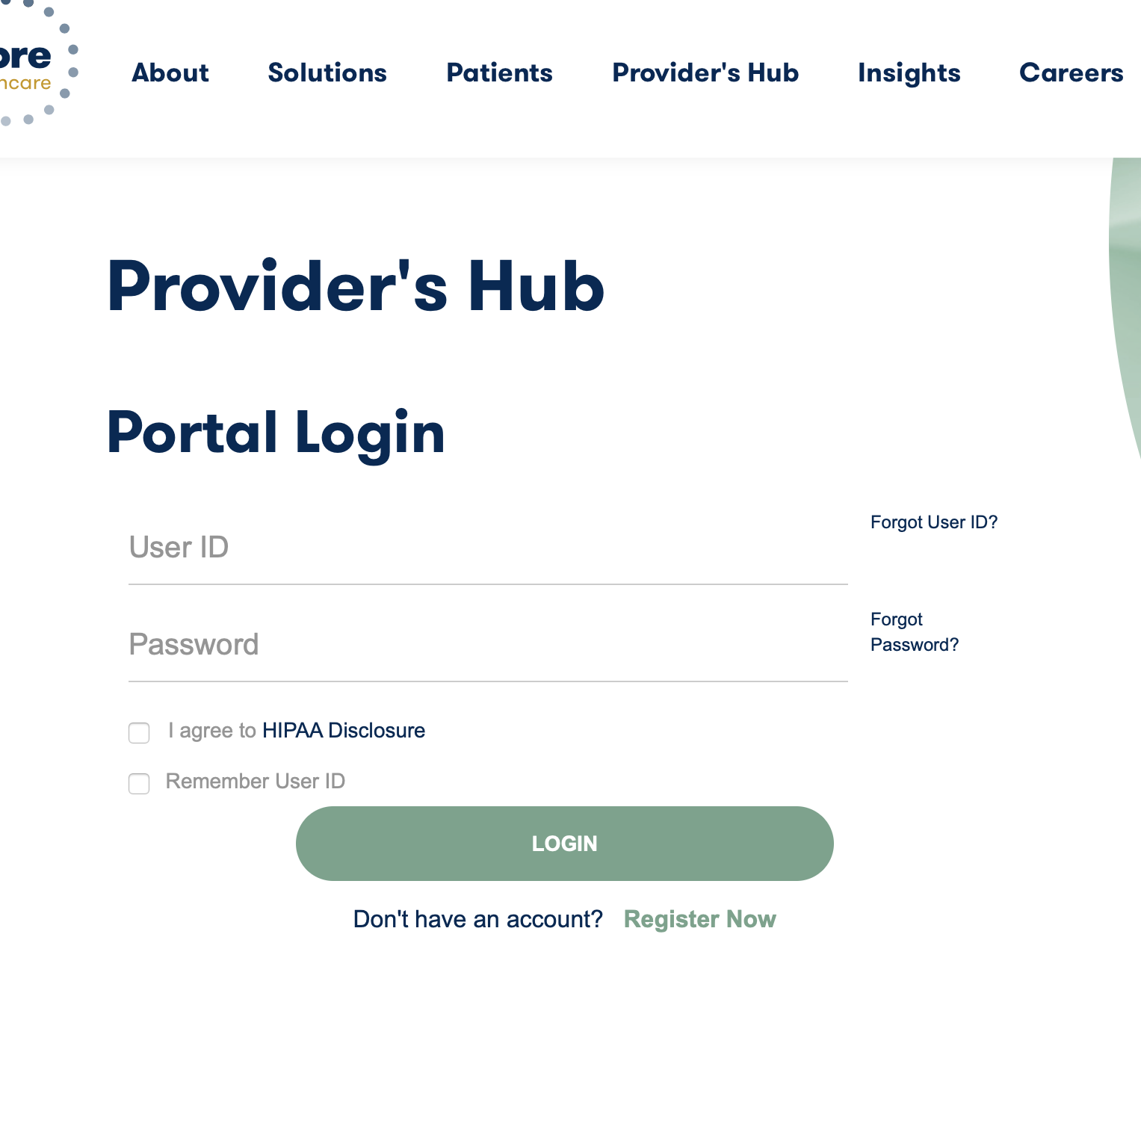
Portal Compatibility
The eviCore.com website is compatible with the following web browsers:
Google Chrome
Mozilla Firefox
Internet Explorer 9, 10, and 11
You may need to disable pop-up blockers to access the site. For information on how to disable pop-up blockers for any of these web browsers, please refer to our Disabling Pop-Up Blockers guide.
Notes:
The eviCore.com website is compatible with the following web browsers:
Google Chrome
Mozilla Firefox
Internet Explorer 9, 10, and 11
You may need to disable pop-up blockers to access the site. For information on how to disable pop-up blockers for any of these web browsers, please refer to our Disabling Pop-Up Blockers guide. From this presentation, you can click on the link in blue, and it will open the instructions for disabling the pop-up blockers.

Slide 28
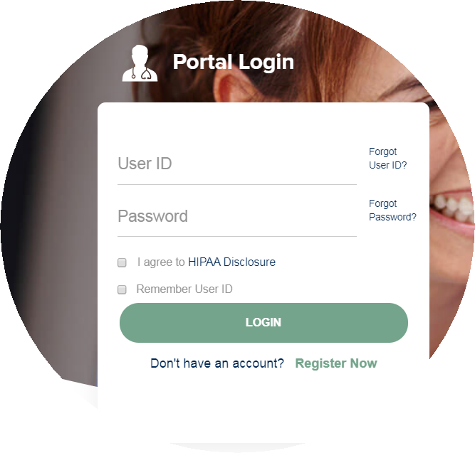
eviCore healthcare Website
Visit www.evicore.com
Already a user?
If you already have access to eviCore’s online portal, simply log-in with your
User ID and Password and begin submitting requests in real-time!
Don’t have an account?
Click “Register Now” and provide the necessary information to receive access today!
Notes:
To access eviCore’s online portal simply visit www.evicore.com.
If you are already registered for the CareCore National portal or MedSolutions Portal 2.0, you will not need to re-register. You can access your account with either set of log-in credentials. This unified login experience allows you to toggle back and forth between the two portals without having to provide additional log-in information.
If you do not currently have an online account, Click the “Register Now” referenced here and follow along with me on these next few slides.

Slide 29
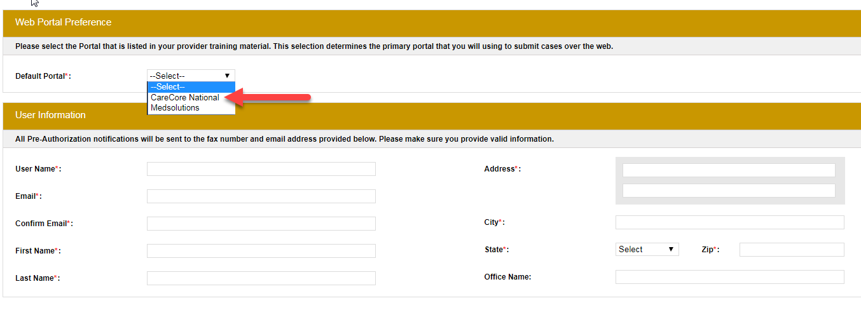
Creating An Account
Select CareCore National as the Default Portal, complete the User Information section in full, and Submit Registration.
You will immediately be sent an email with a link to create a password. Once you have created a password, you will be redirected to the log-in page.

Slide 30
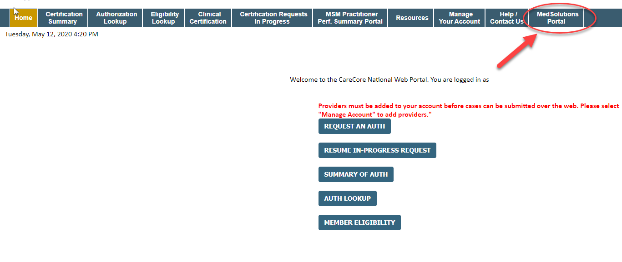
Welcome Screen
Note: You can access the MedSolutions Portal at any time without having to provide additional log-in information. Click the MedSolutions Portal on the top-right corner to seamlessly toggle back and forth between the two portals.
Notes:
Providers will need to be added to your account prior to case submission. Click the “Manage Account” tab to add provider information.
Note: You can access the MedSolutions Portal at any time if you are registered. Click the MedSolutions Portal button on the top right corner to seamlessly toggle back and forth between the two portals without having to log-in multiple accounts.

Slide 31
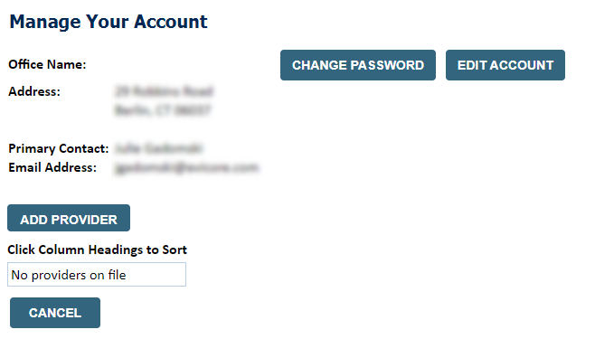
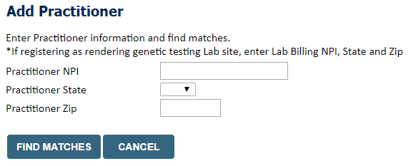
Add Practitioners
Select the “Manage Your Account” tab, then the Add Provider
Enter the NPI, state, and zip code to search for the provider
Select the matching record based upon your search criteria
Once you have selected a practitioner, your registration will be complete
You can also click “Add Another Practitioner” to add another provider to your account
You can access the “Manage Your Account” at any time to make any necessary updates or changes
Notes:
Under the “Manage Your Account” tab Click the “Add Provider” button.

Slide 32
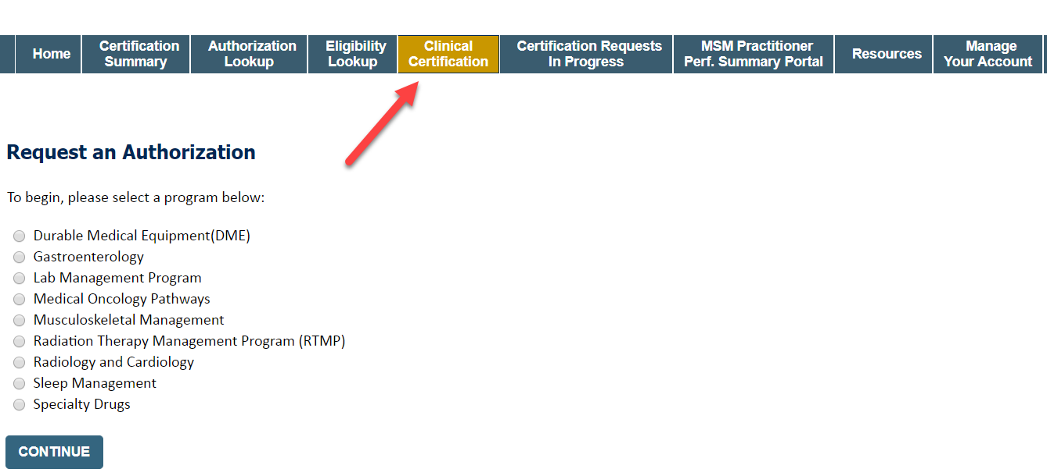
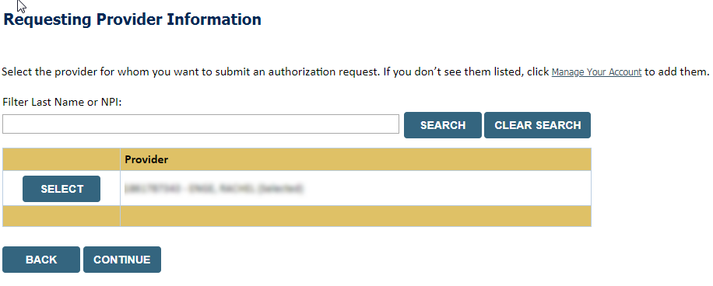
Initiating A Case
Choose Clinical Certification to begin a new request
Select the appropriate program
Select “Requesting Provider Information”
Notes:
Choose clinical certification at the top of the portal, then select the appropriate program. One you continue you will be prompted to select the requesting provider which your providers should already be entered. You can filter by last name or NPI if you have a lot of providers added to your account.
These choices will also be on the header bar coming later.

Slide 33
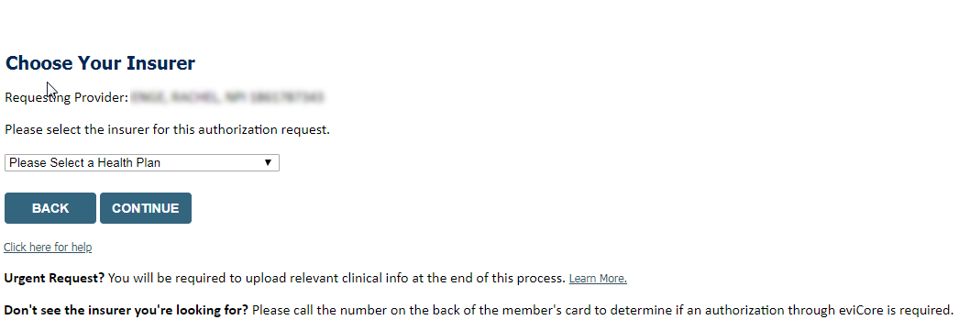
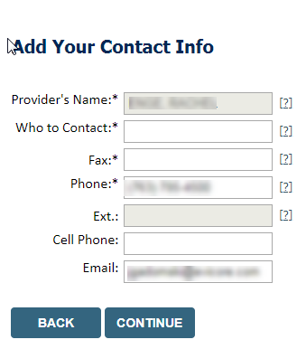
Select Health Plan & Provider Contact Info
Choose the appropriate Health Plan for the request
Once the plan is chosen, select the provider address in the next drop-down box
Select CONTINUE and on the next screen Add your contact info
Provider name, fax and phone will pre-populate, you can edit as necessary
By entering a valid email you can receive e-notifications [confirm for new implementation]
Notes:
Select the health plan and provider’s address to continue.

Slide 34
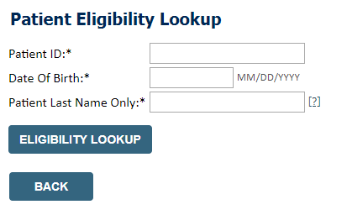
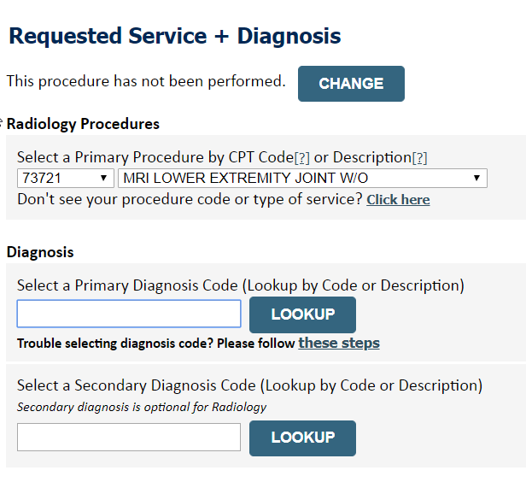
Member & Request Information
Enter the member information, including the patient ID number, date of birth, and last name. Click Eligibility Lookup
Next screen you can enter CPT code & diagnosis code
Notes:
Enter patient info, and please use forward slashes to separate month/day/year when entering the DOB; all three fields are required. Once entered click on “Eligibility Lookup” and select from the list of patients that are displayed, which may include an entire family; then click continue.

Slide 35
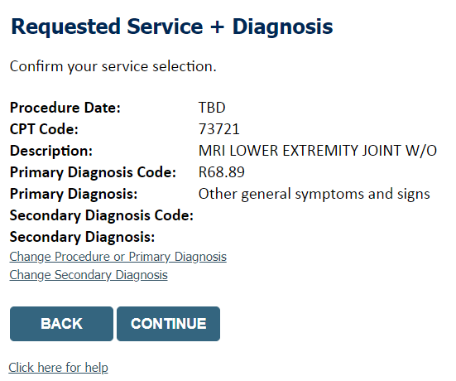
Verify Service Selection
Verify requested service & diagnosis
Edit any information if needed by selecting Change Procedure or Primary Diagnosis
Click continue to confirm your selection
Notes:
Confirm your selections, you have the ability to edit and correct the information by selecting the edit button next to “physician”. Do not use the back button in this instance, it may loose the information that you have already entered.

Slide 36
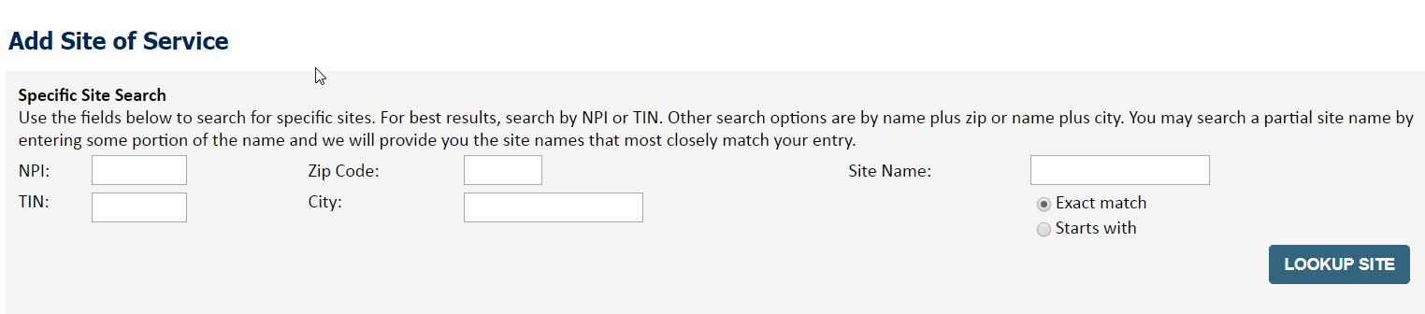
Site Selection
Start by searching NPI or TIN for the site where the procedure will be performed. You can search by any fields listed. Searching with NPI, TIN, and zip code is the most efficient.
Select the specific site where the testing/treatment will be performed.
Notes:
This is your specific site search. Enter the zip code along with the first word of the facility name or the last name of the rendering practitioner only, and then look up the site. The more information you enter the greater the chance of it not finding the site. The zip code you enter should be tied to the facility site. Once you have selected an option the continue button will appear.

Slide 37
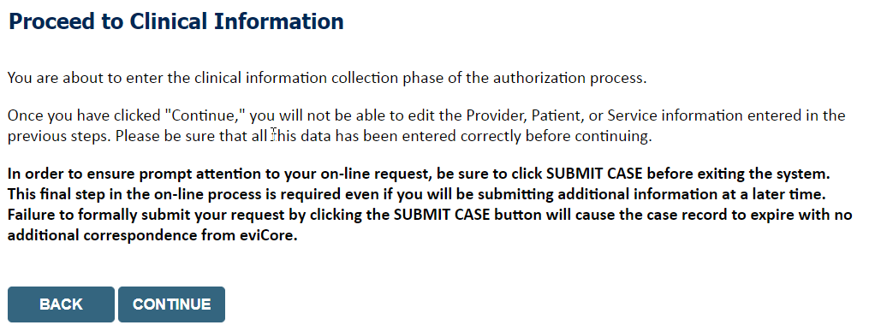
Clinical Certification
Verify that all information is entered and make any changes needed
You will not have the opportunity to make changes after this point
Notes:
Now you're entering the clinical pathway. If you need to confirm information you are entering or need to add additional data check “finish later” and then the submit button. You will have two business day to complete the case.

Slide 38
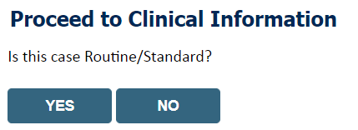
Standard or Urgent Request?
If your request is urgent select No
When a request is submitted as Urgent, you will be required to upload relevant clinical information
If the case is standard select Yes
You can upload up to FIVE documents in .doc, .docx, or .pdf format
Your case will only be considered Urgent if there is a successful upload
Notes:
Select an Urgency Indicator and Upload your patient’s relevant medical records that support your request. You can upload up to FIVE documents in .doc, .docx, or .pdf format. Your case will only be considered Urgent if there is a successful upload.
If your request is urgent select No, if the case is standard select Yes.

Slide 39
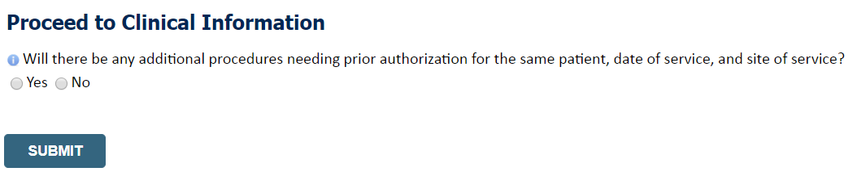
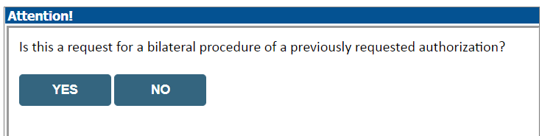
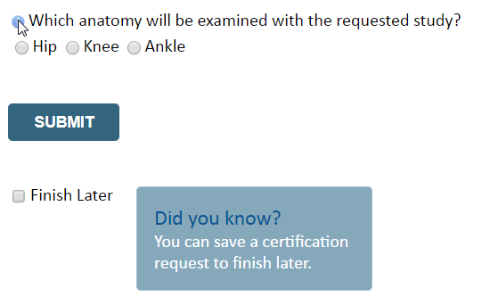
Proceed to Clinical Information – Example of Questions
Clinical Certification questions may populate based upon the information provided
You can save your request and finish later if needed
Note: You will have 2 business days to complete the case
When logged in, you can resume a saved request by going to Certification Requests in Progress
Notes:
Now you're entering the clinical pathway. If you need to confirm information you are entering or need to add additional data check “finish later” and then the submit button. You will have two business day to complete the case.

Slide 40
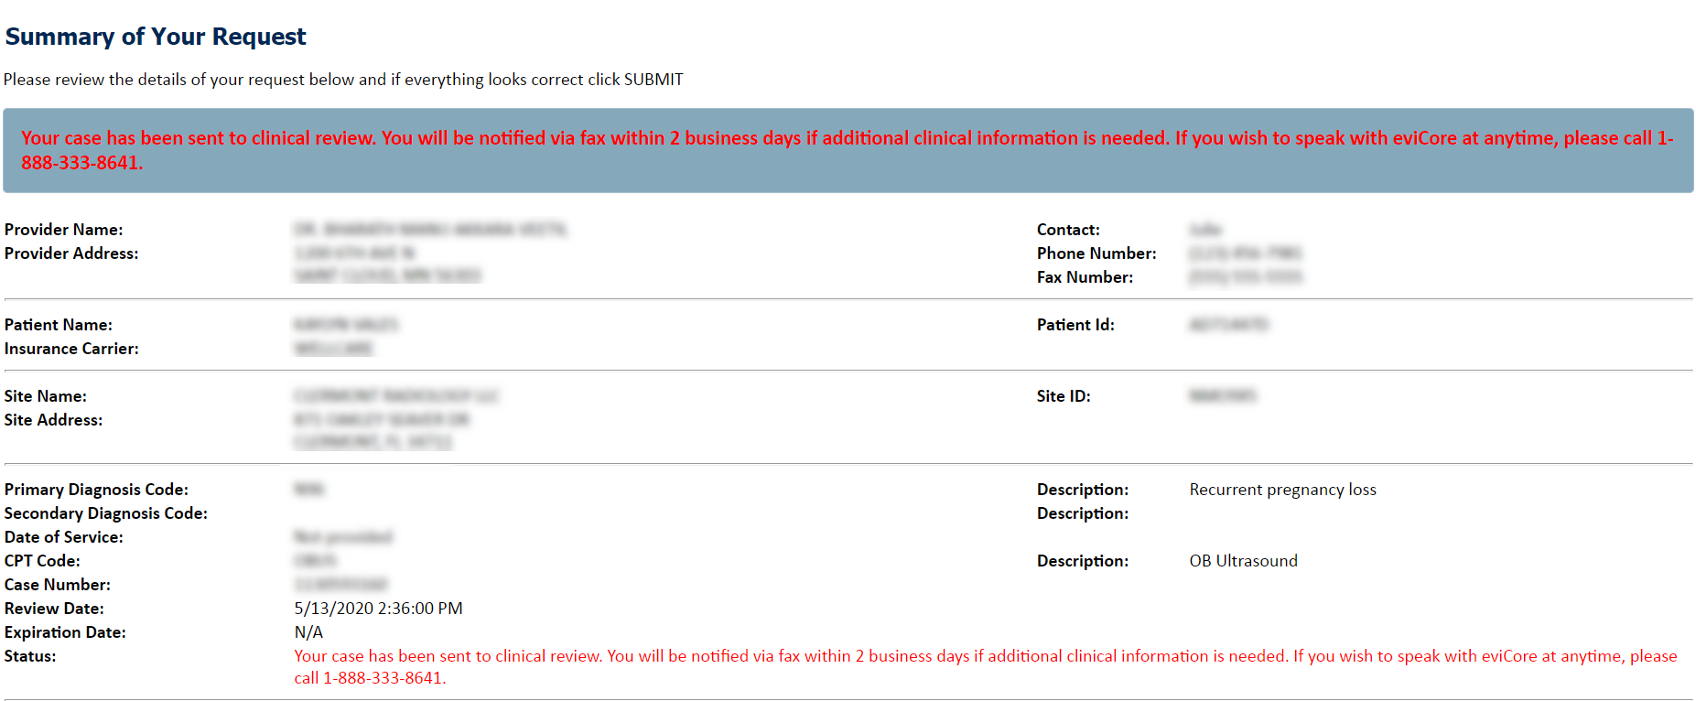
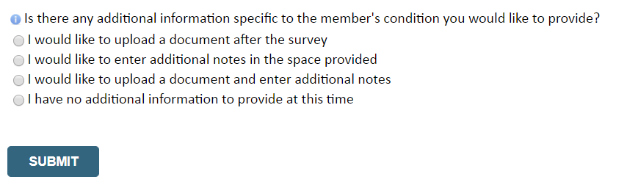
Next Step: Criteria not met
If criteria are not met based on clinical questions, you will receive a similar request for additional info:
Tips:
Upload clinical notes on the portal, to avoid any delays (e.g., by faxing)
Enter additional notes in the space provided only when necessary
Additional information uploaded to the case will be sent for clinical review
Print-out a summary of the request that includes the case # and indicates ‘Your case has been sent to clinical review’
Notes:
Now you're entering the clinical pathway. If you need to confirm information you are entering or need to add additional data check “finish later” and then the submit button. You will have two business day to complete the case.

Slide 41
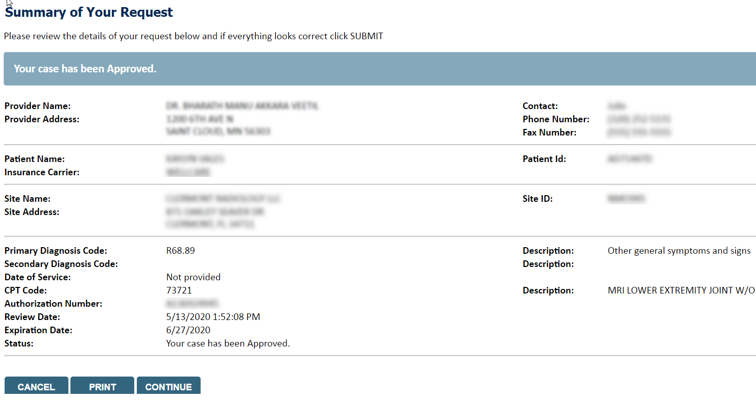
Criteria Met
If your request is authorized during the initial submission, you can print the summary of the request for your records.
Notes:
Now you're entering the clinical pathway. If you need to confirm information you are entering or need to add additional data check “finish later” and then the submit button. You will have two business day to complete the case.

Slide 42
Additional Provider Portal Features

Slide 43
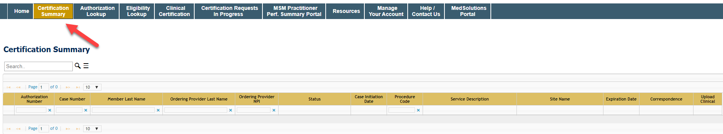
Certification Summary
Certification Summary tab allows you to track recently submitted cases
The work list can also be filtered
Notes:
CareCore National Portal now includes a Certification Summary tab, to better track your recently submitted cases.
The work list can also be filtered - as seen above.

Slide 44
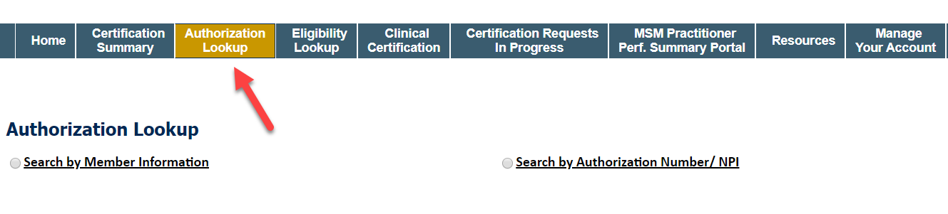
Authorization Lookup
You can look-up authorization status on the portal
Search by member information OR
Search by authorization number with ordering NPI
View and print any correspondence
Notes:
CareCore National Portal now includes a Certification Summary tab, to better track your recently submitted cases.
The work list can also be filtered - as seen above.

Slide 45
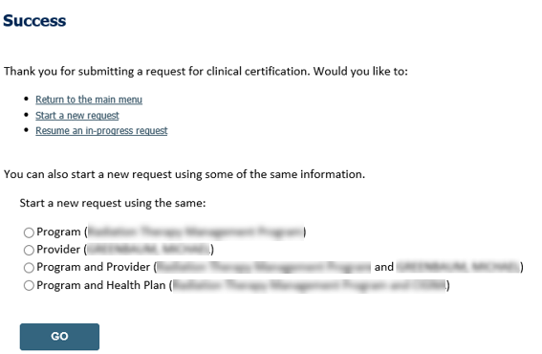
Duplication Feature
Duplicate feature allows you to start a new request using same information
Eliminates entering duplicate information
Time saver!
Notes:
If you have additional requests you need to submit for prior authorization, we have duplication feature. This allows you to copy over the program and or provider information to save time.

Slide 46

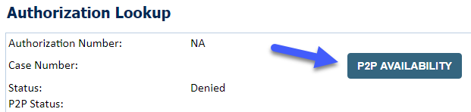
How to schedule a Peer to Peer Request
Log into your account at www.evicore.com
Perform Authorization Lookup to determine the status of your request.
Click on the “P2P Availability” button to determine if your case is eligible for a Peer to Peer conversation:
  If your case is eligible for a Peer to Peer conversation, a link will display allowing you to proceed to scheduling without any additional messaging.

Slide 47
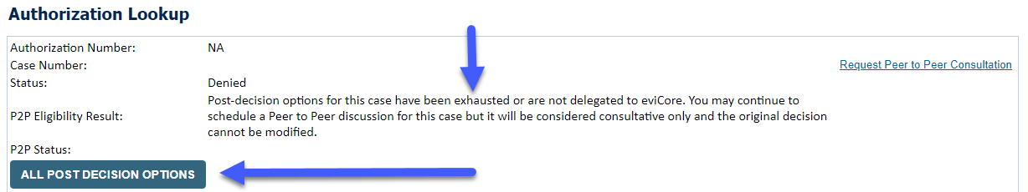
How to schedule a Peer to Peer Request
  Pay attention to any messaging that displays. In some instances, a Peer to Peer conversation is allowed, but the case decision cannot be changed. When this happens, you can still request a Consultative Only Peer to Peer. You may also click on the “All Post Decision Options” button to learn what other action may be taken.
  Once the “Request Peer to Peer Consultation” link is selected, you will be transferred to our scheduling software via a new browser window.

Slide 48
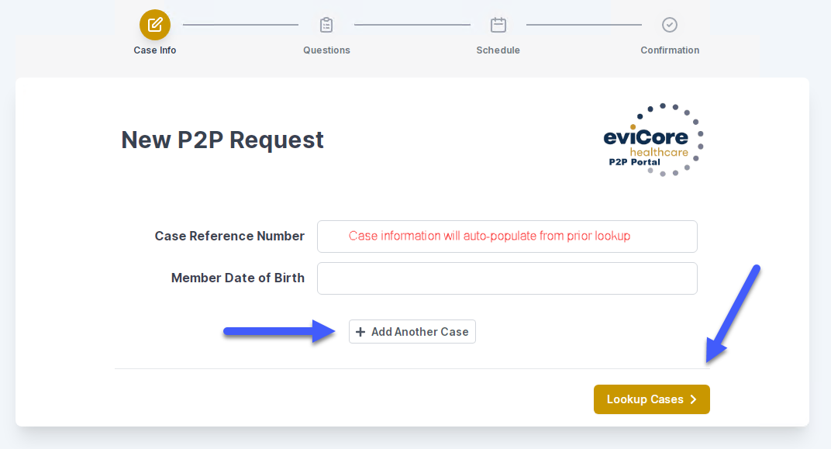
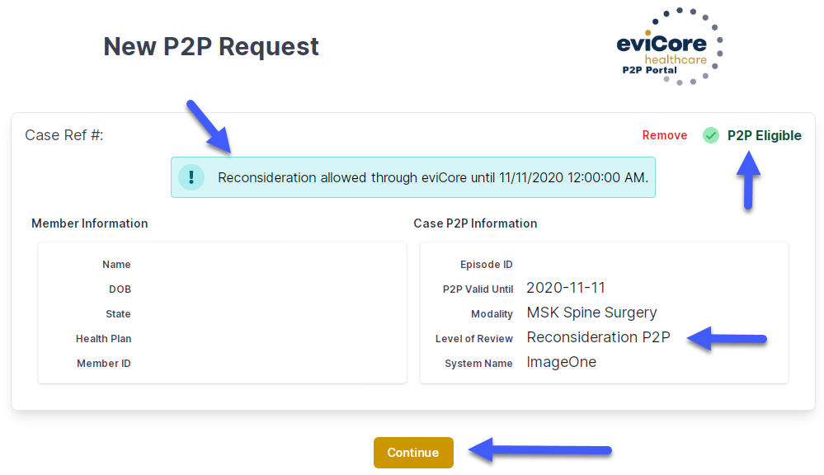
How to Schedule a Peer to Peer Request
Upon first login, you will be asked to confirm your default time zone.
You will be presented with the Case Number and Member Date of Birth (DOB) for the case you just looked up.
You can add another case for the same Peer to Peer appointment request by selecting “Add Another Case”
  To proceed, select “Lookup Cases”
You will receive a confirmation screen with member and case information, including the Level of Review for the case in question. Click Continue to proceed.
Notes:
Note! You can add another case for the same Peer to Peer appointment request by selecting “Add Another Case” (maximum of 4 cases, some restrictions may apply*)
There might be times when we are unable to accommodate more than one case with the same eviCore reviewer. This is usually because different credentials or licensure types are needed for one or more of the cases in question. You will receive a prompt to schedule these separately when this occurs.

Slide 49
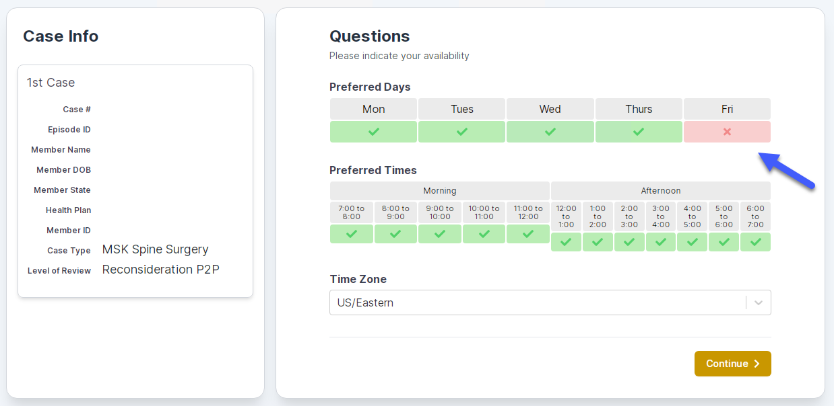
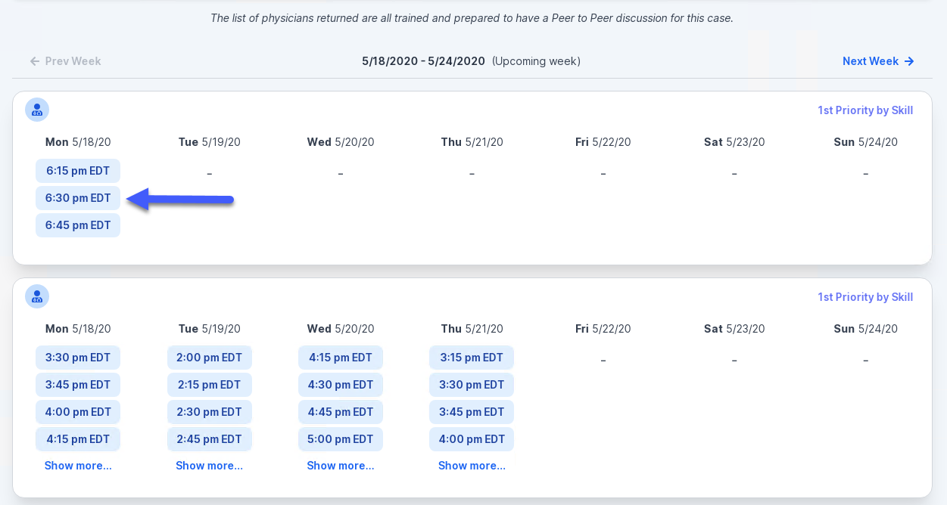
How to Schedule a Peer to Peer Request
You will be prompted to identify your preferred Days and Times for a Peer to Peer conversation. All opportunities will automatically present. Click on any green check mark to deselect the option and then click Continue.
You will be prompted with a list of eviCore Physicians/Reviewers and appointment options per your availability. Select any of the listed appointment times to continue.

Slide 50
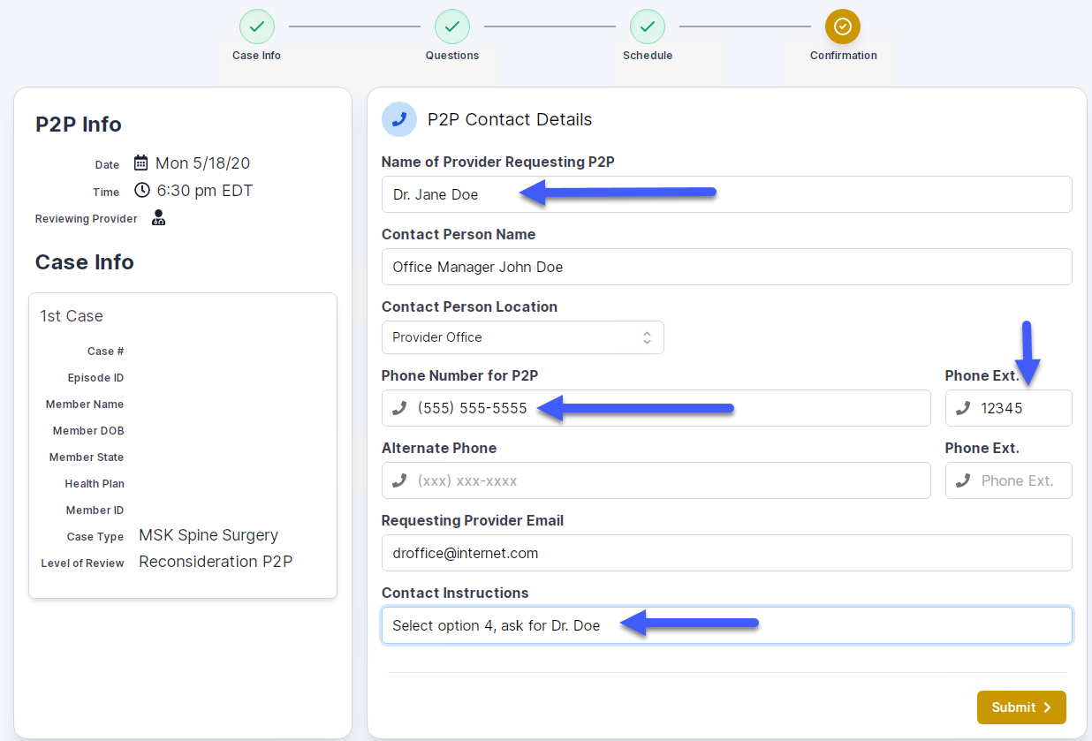
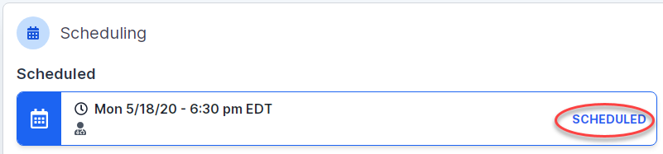
How to Schedule a Peer to Peer
Confirm Contact Details
  Contact Person Name and Email Address will auto-populate per
  your user credentials
  Be sure to update the following fields so that we can reach the right person for the Peer to Peer appointment:
    Name of Provider Requesting P2P
    Phone Number for P2P
    Contact Instructions
    Click submit to schedule appointment. You will be presented with a summary page containing the details of your scheduled appointment.
Notes:
Note: You will also receive a confirmation email with a calendar invite to the Peer to Peer appointment.

Slide 51
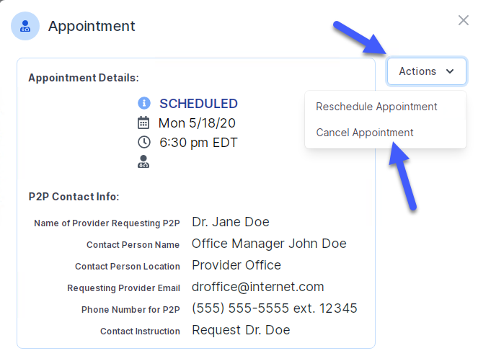
Canceling or Rescheduling a Peer to Peer Appointment
To cancel or reschedule an appointment
Access the scheduling software per the instructions above
Go to “My P2P Requests” on the left pane navigation.
Select the request you would like to modify from the list of available appointments
Once opened, click on the schedule link. An appointment window will open
Click on the Actions drop-down and choose the appropriate action
If choosing to reschedule, you will have the opportunity to select a new date or time as you did initially.
If choosing to cancel, you will be prompted to input a cancellation reason
Close browser once done

Slide 52
Provider Resources

Slide 53

Dedicated Call Center
Prior Authorization Call Center: 844-303-8451
Our call centers are open from 7 a.m. to 7 p.m. (local time).
Providers can contact our call center to perform the following:
Request Prior Authorization
Check Status of existing authorization requests
Discuss questions regarding authorizations and case decisions
Change facility or CPT Code(s) on an existing case
Request to speak to a clinical reviewer
Schedule a clinical consultation with an eviCore Medical Director

Slide 54
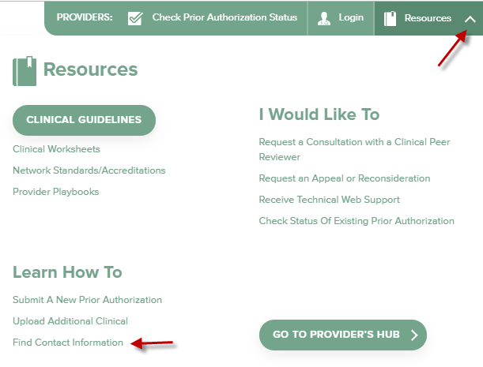
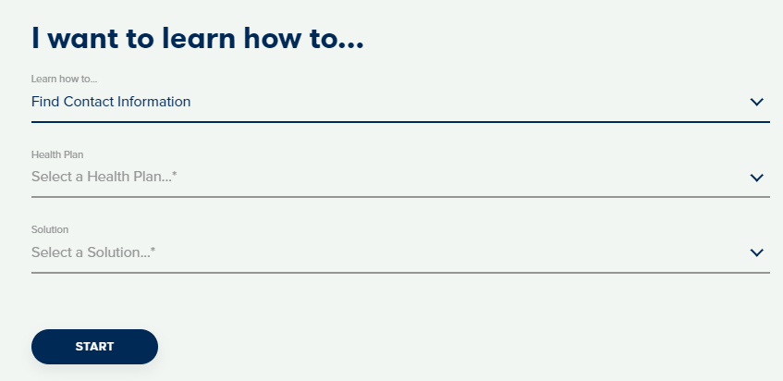
Online Resources
Web-Based Services and Online Resources
You can access important tools, health plan-specific contact information, and resources at www.evicore.com
Select the Resources to view Clinical Guidelines, Online Forms, and more.
Provider’s Hub section includes many resources
Provider forums and portal training are offered weekly, you can find a session on www.eviCore.WebEx.com, select WebEx Training, and search upcoming for a “eviCore Portal Training” or “Provider Resource Review Forum”
The quickest, most efficient way to request prior authorization is through our provider portal. Our dedicated Web Support team can assist providers in navigating the portal and addressing any web-related issues during the online submission process.
To speak with a Web Specialist, call (800) 646-0418 (Option #2) or email portal.support@evicore.com

Slide 55

Client & Provider Operations Team
Client and Provider Services
Dedicated team to address provider-related requests and concerns including:
Questions regarding Accuracy Assessment, Accreditation, and/or Credentialing
Requests for an authorization to be resent to the health plan
Consumer Engagement Inquiries
Eligibility issues (member, rendering facility, and/or ordering physician)
Issues experienced during case creation
Reports of system issues
How to Contact our Client and Provider Services team
Email: ClientServices@evicore.com (preferred)
Phone: 1 (800) 646 - 0418 (option 4)
For prompt service, please have all pertinent information available. When emailing, make sure to include the health plan in the subject line with a description of the issue, with member/provider/case details when applicable.

Slide 56
Provider Engagement Team
Provider Engagement team
Regional team that on-boards providers for new solutions and provides continued support to the provider community. How can the provider engagement team help?
Partner with the health plan to create a market-readiness strategy for a new and/or existing program
Conduct onsite and WebEx provider-orientation sessions
Provide education to supporting staff to improve overall experience and efficiency
Create training materials
Monitor and review metrics and overall activity
Conduct provider-outreach activities when opportunities for improvement have been identified
Generate and review provider profile reports specific to a TIN or NPI
Facilitate clinical discussions with ordering providers and eviCore medical directors
How to contact the Provider Engagement team?
You can find a list of Regional Provider Engagement Managers at evicore.com → Provider’s Hub → Training Resources

Slide 57

Provider Resource Website
Provider Resource Pages
eviCore’s Provider Experience team maintains provider resource pages that contain client- and solution-specific educational materials to assist providers and their staff on a daily basis. The provider resource page will include, but is not limited to, the following educational materials:
Frequently Asked Questions
Quick Reference Guides
Provider Training
CPT code list
To access these helpful resources, please visit https://www.evicore.com/resources/healthplan/SummitHealth

Slide 58

Provider Newsletter
Stay Updated With Our Free Provider Newsletter
eviCore’s provider newsletter is sent out to the provider community with important updates and tips. If you are interested in staying current, feel free to subscribe:
Go to eviCore.com
Scroll down and add a valid email to subscribe
You will begin receiving email provider newsletters with updates

Slide 59

Provider Resource Review Forums
The eviCore website contains multiple tools and resources to assist providers and their staff during the prior authorization process.
We invite you to attend a Provider Resource Review Forum, to navigate www.eviCore.com and understand all the resources available on the Provider’s Hub. Learn how to access:
eviCore’s evidence-based clinical guidelines
Clinical worksheets
Check-status function of existing prior authorization
Search for contact information
Podcasts & Insights
Training resources
How to register for a Provider Resource Review Forum?
You can find a list of scheduled Provider Resource Review Forums on www.eviCore.com → Provider’s Hub → Scroll down to eviCore Provider Orientation Session Registrations → Upcoming

Slide 60

Thank You!
Notes:
Thank you so much for joining the eviCore web portal training session. Please note that your experience may vary slightly depending upon the solution. As a reminder, I will be emailing a copy of this presentation to the email that you registered with.
Are there any questions?
Have a wonderful day!

